Slide 1

TREDLite – An Agency Focused, Customized Transportation Analytics Platform
Modern Mobility Conference | September 15, 2025
Presented by Chris Gregerson, P.E., T.E., AICP

Slide 2







TREDLite VMT Timeline
September 2013
Darrel Steinberg leads SB 743 to passage
August 2014
OPR releases preliminary discussion draft of guidelines
January 2016
OPR publishes revised guidelines
October 2018
OPR publishes “Final” guidelines
November 2019
KH begins preparing guidelines/
VMT Tool
May 2020
Caltrans publishes Transportation Impact Study Guide
June 2020
KH presents at Western ITE Conference
August 2021
CAPCOA releases new TDM/GHG guidelines
2013
2014
2016
2018
2019
2020
2021
December 2014
Pasadena adopts VMT for CEQA analysis
March 2016
San Francisco adopts guidelines
November 2019
Citizens for Positive Growth & Preservation v. City of Sacramento
July 2020
SB 743 Implementation required
June 2021
Caltrans and OPR kick-off multi-year working group
October 2021
KH TREDLite rollout

Slide 3





What Can the TREDLite Tool Do?
Regulate Environmental Impacts
Estimate Greenhouse Gas Emissions
Run Mitigation Scenarios
Calculate Internal Trip Capture
Explore Data Quickly and Easily

Slide 4






When to Use TREDLite VMT
TREDLite can be used on a variety of projects:
Transportation Planning
Travel Demand Modeling
Site Selection
Land Development
Traffic Analysis
and Engineering
Carbon Reduction Programs

Slide 5

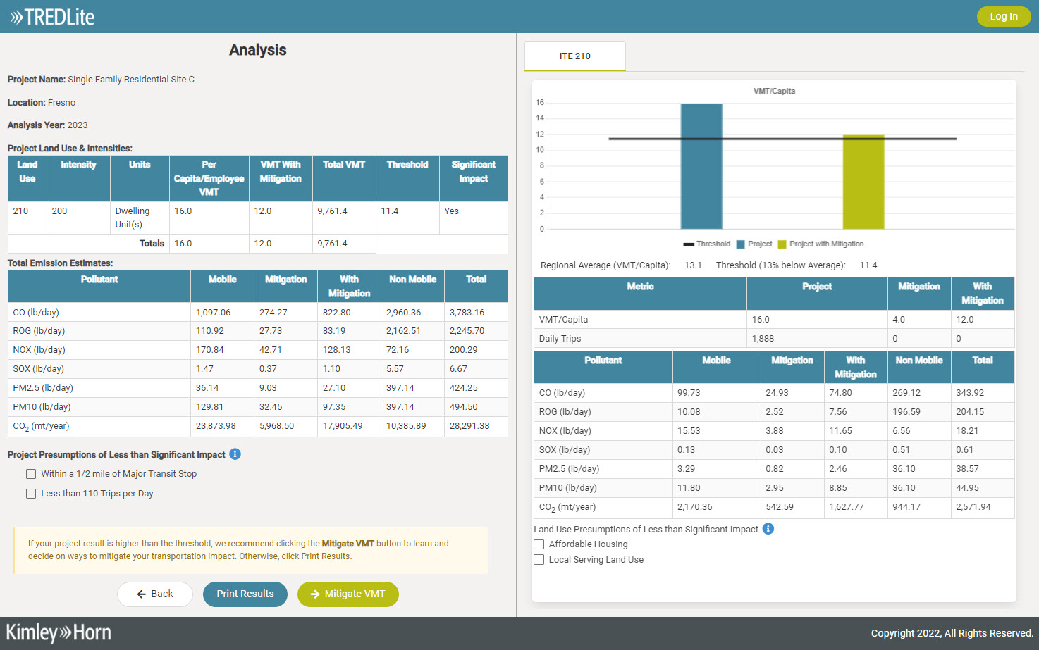
How Does TREDLite Work?
TREDLite uses big data or travel demand model data to specially estimate the VMT generated by various land uses.
The user inputs land use data to model different land development scenarios and output VMT/GHG projections.
The user can also test various VMT/GHG reduction strategies to estimate their efficacy spatially.

Slide 6
Case Study #1: San Luis Obispo

Slide 7
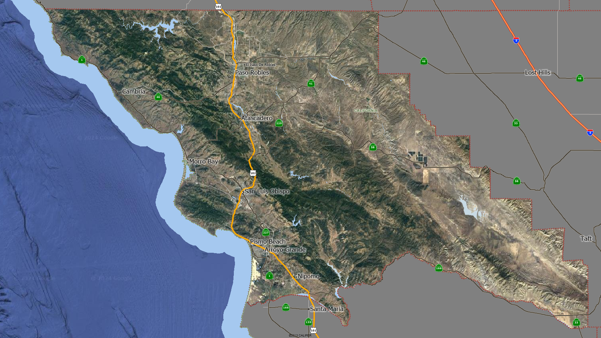
1
Case Study #1 Location

Slide 8



Urban
Case Study: San Luis Obispo | Residential Development
A proposed 100-unit multi-family residential project was evaluated for its impact on vehicle miles traveled.
Challenge
Solution
Results
Developing 100 multi-family residential units (ITE LU Code 221) often raises concerns about increased vehicles miles traveled (VMT), which can trigger costly mitigation requirements under California’s VMT thresholds.
The project was evaluated for VMT per capita:
Project VMT/Capita: 10.0
Regional Threshold: 14.3 VMT/Capita
Result: 30% below the threshold
VMT Results: No significant impact
Mitigation Cost: $0 (fully under threshold)
Conclusion: The location and design of the project support sustainable travel behavior, avoiding the need for mitigation. Further development in this area should be explored.

Slide 9
Mitigation Cost: $0
1
Case Study #1 Result

Slide 10
Case Study #2: SLO County | Creston

Slide 11
2
Case Study #2 Location

Slide 12
Rural
Case Study: SLO County Creston | Residential Development
A proposed 100-unit single-family residential project near Creston was evaluated for its VMT impact.
Challenge
Solution
Results
Rural residential developments often result in significantly higher VMT due to limited access to transit and services, raising concerns about sustainability and mitigation costs.
The project was evaluated for VMT per capita:
Project VMT/Capita: 70.6
Threshold: 27.2 VMT/Capita
Result: 159% above the threshold
VMT Results: Above threshold
Mitigation Cost: $12.8 million total (~$128,000 per home)
Conclusion: The project’s remote location leads to long trips, requiring substantial mitigation investment to meet VMT standards. Residential development would need to be supported by other land uses to reduce trip lengths

Slide 13
Mitigation Cost: $12.8m
2
Case Study #2 Result

